Slide 1

Analysis of Terry Stops in Seattle
Randell Mwania

Slide 2

Problem
CLASSIFICATION MODELS of PREDICTING ARRESTS IN SEATTLE
Recognizing intricate patterns and discerning the key variables that significantly impact the outcomes of Terry stops.
The objective involves leveraging data analytics to identify subtle and complex patterns within the Terry stops dataset. The aim is to understand the interplay of various variables and factors contributing to the arrest outcomes.
Goal:
Fostering fairness, transparency, and accountability in law enforcement decision-making during Terry stops.
The overarching goal is to utilize the insights gained from the analysis to empower law enforcement agencies with knowledge that supports fair, transparent, and accountable decision-making processes. By understanding the factors influencing arrest outcomes, the goal is to contribute to a more just and equitable policing system.

Slide 3
Business Understanding
Real-world Problem
Terry Stops and Policing Dynamics: Terry stops represent a critical aspect of policing, allowing officers to briefly detain individuals based on reasonable suspicion. The challenge lies in understanding the nuanced variables that influence the outcomes of these stops, particularly in terms of arrests.
Stakeholders
Community Stakeholders: Members of the community are directly impacted by law enforcement decisions during Terry stops. Understanding these decisions is vital for community trust and collaboration.
Law Enforcement Agencies: Police departments aim to enhance the effectiveness and fairness of their operations. Identifying patterns in Terry stops contributes to informed decision-making.
Project's Contribution
Fairness and Accountability: The project's goal is to contribute to fairness and accountability in law enforcement by recognizing patterns and variables affecting arrest outcomes during Terry stops.
Data-Driven Insights: Leveraging data-driven insights, the project aims to provide valuable information to stakeholders, fostering transparency and informed decision-making.
Problem Dynamics
Interplay of Variables: Recognizing the intricate dynamics between various demographic variables and arrest outcomes is essential. This understanding enables proactive measures to address potential biases.
Impact on Stakeholders
Building Trust: By addressing the challenges in Terry stops, the project strives to build and strengthen trust between law enforcement and the community.
Informed Decision-Making: Law enforcement agencies can benefit from the project's insights to make more informed, fair, and accountable decisions during Terry stops.

Slide 4
overview
Data Understanding
The overarching goal is to utilize the insights gained from the analysis to empower law enforcement agencies with knowledge that supports fair, transparent, and accountable decision-making processes. By understanding the factors influencing arrest outcomes, the goal is to contribute to a more just and equitable policing system.
Source: Seattle Police Department records.
Size: 58,167 Terry stops.
Target Variable: 'Arrest Flag' indicating arrest outcomes.

Slide 5
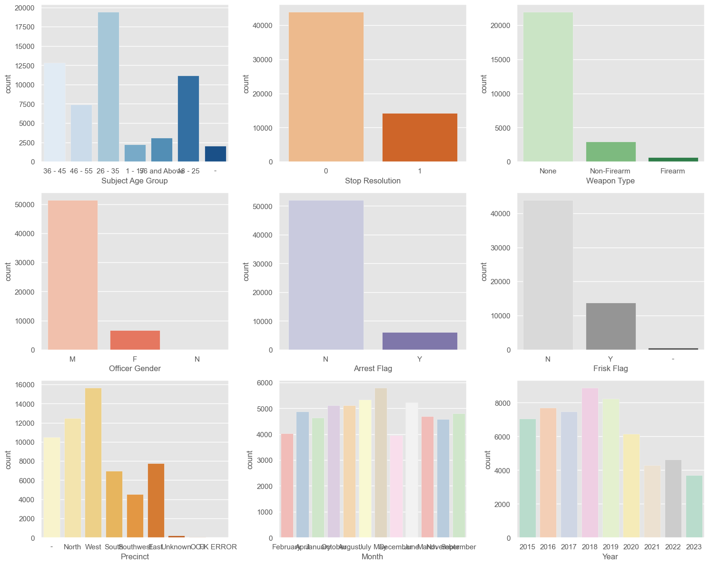
variations across different attributes
In these visualizations, we observe variations across different attributes. The 'Stop Resolution' plot, in particular, indicates that approximately a quarter of Terry stops result in an arrest.

Slide 6
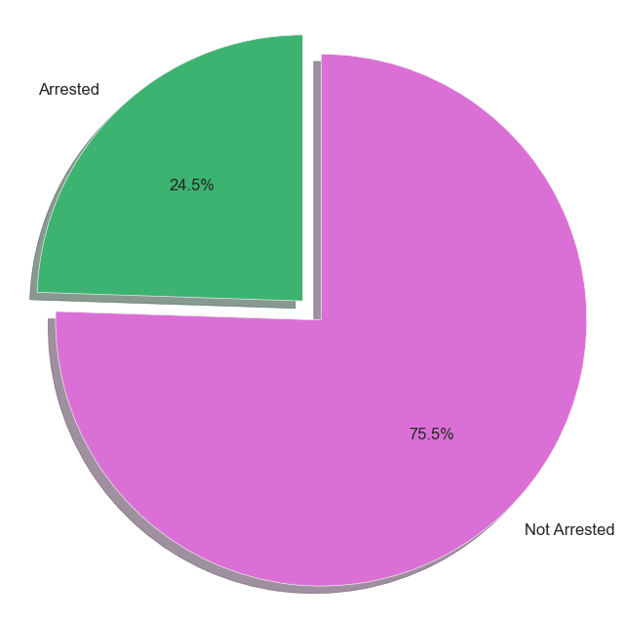
percentage of arrests vs. non-arrests
This pie chart illustrates that just under 24.5% of Terry stops culminate in an arrest.Continuing our exploration, we investigate the relationship between arrests made during stops and those determined as the final resolution, shedding light on potential delays in arrest outcomes.

Slide 7
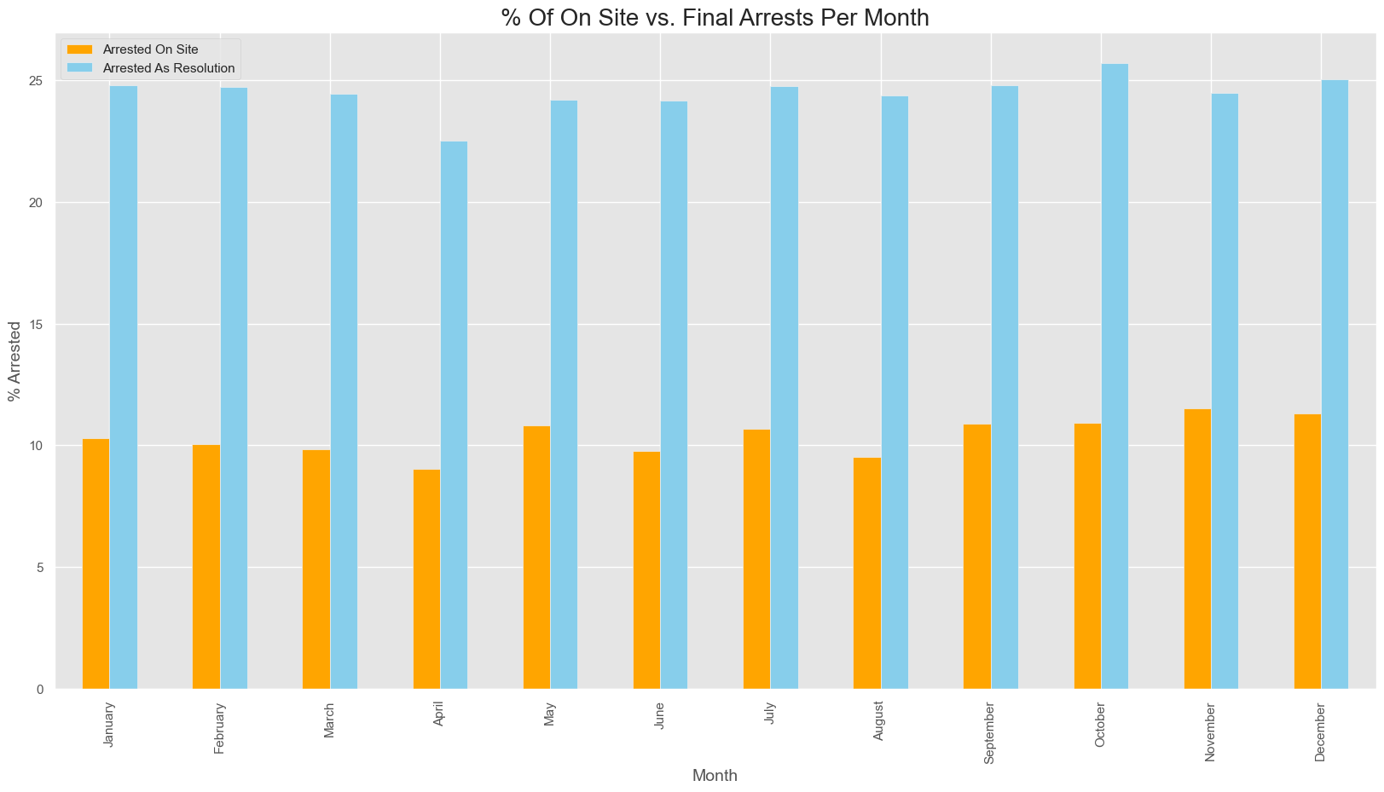
the relationship between arrests made during stops and final resolution
This analysis uncovers that, on average, less than 10% of stops result in immediate arrests. However, there's a substantial increase in the percentage of arrests determined as the final solution after the initial stop.

Slide 8
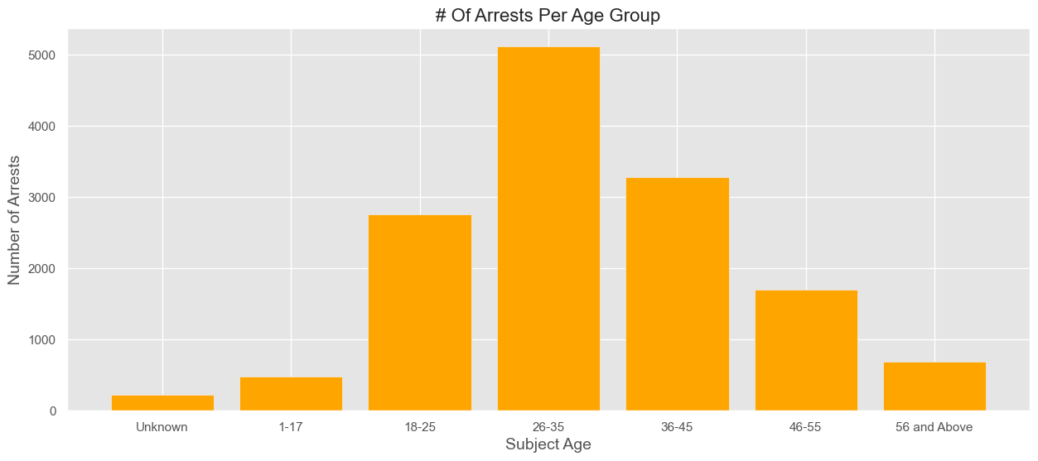
Age Group Analysis
Notably, individuals aged 26-35 are more frequently involved in arrests.

Slide 9
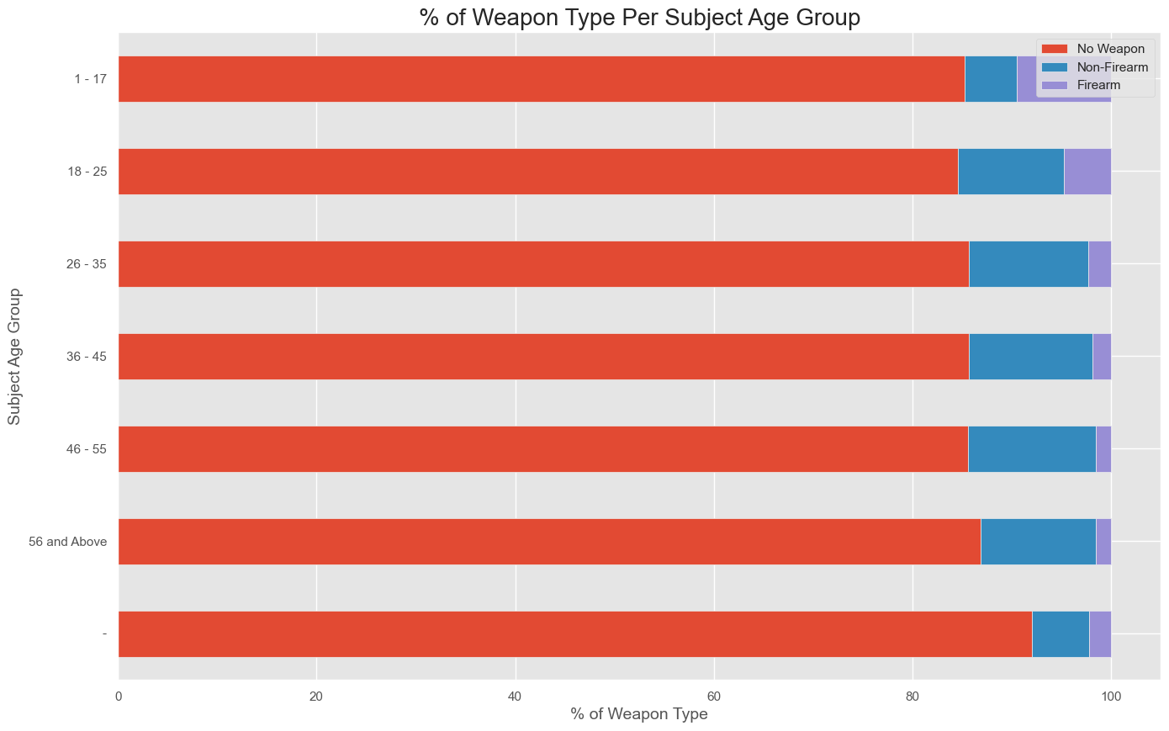
% of Weapon Type Per Subject Age Group

Slide 10
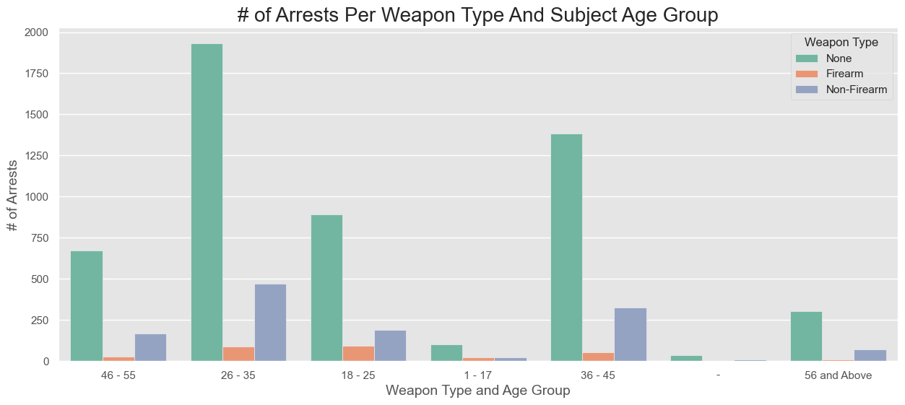
Number of Arrests Per Weapon Type And Subject Age Group
Observations:-
Similar to the overall trend, most arrests show no involvement of weapons.
- Notable spikes in weapons (both firearm and non-firearm) occur in the 18-25 and 26-35 age ranges.
- The 36-45 age range also exhibits a spike in non-firearm weapons.

Slide 11
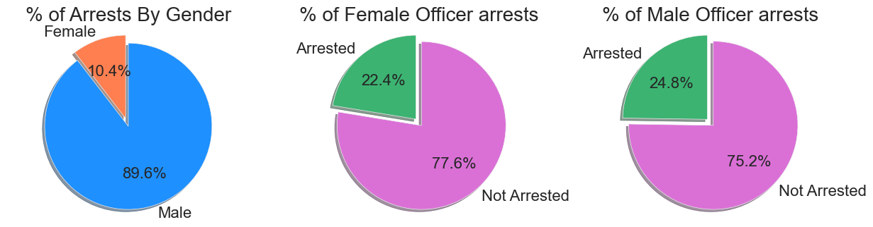
Officers by gender
Observations:
- Most arrests are made by male officers, reflecting the overall gender distribution among officers.
- When examining each gender individually, the arrest rates are similar.

Slide 12
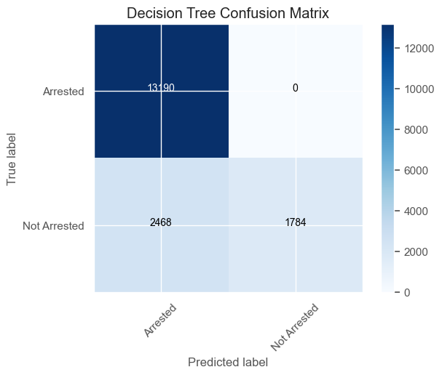
Decision tree confusion matrix
From the confusion matrix we see a lot of true arrests were made with a few false arrests by the decision tree.

Slide 13
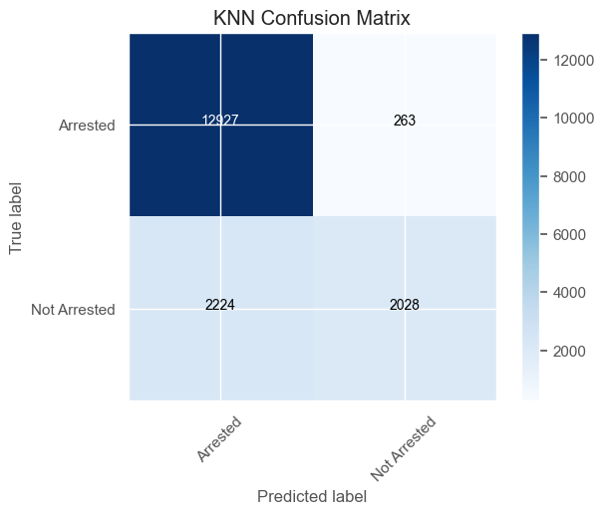
Knn confusion matrix
From the confusion matrix we see a lot of true arrests were made with a few false arrests by the decision tree but less than in the decision tree confusion matrix.

Slide 14
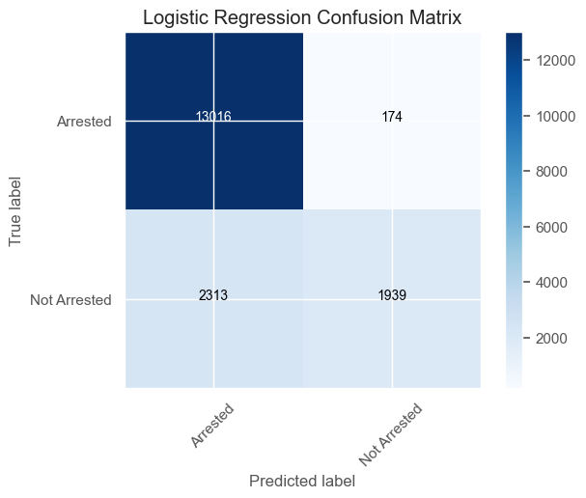
Logistic regression confusion matrix
From the confusion matrix we see a lot of true arrests were made with a few false arrests by the decision tree but less than in the decision tree confusion matrix but more than the KNN confusion matrix.

Slide 15
Modeling Process
Steps
Data Cleaning: Ensuring data integrity and addressing missing values.
Feature Selection and Engineering: Identifying key variables for analysis.
Model Training and Evaluation: Employing Decision Tree, K-Nearest Neighbors (KNN), and Logistic Regression models.

Slide 16
Model Performance
Decision Tree
Accuracy: 85.85%
Insights: High accuracy in classifying Terry stop outcomes.
K-Nearest Neighbors (KNN)
Accuracy: 85.74%
Insights: Competitive performance, relying on instance similarity.
Logistic Regression
Accuracy: 85.74%
Insights: Effective binary classification with logistic regression.

Slide 17

coefficients of the linear regression model
Key Observations
Gender Impact: Male officers significantly contribute to arrest outcomes.
Weapon Incidents: Most arrests involve no weapons.
Age Dynamics: Age group 26-35 more frequently involved in arrests.
Officer Training
Objective: Enhance judgment on arrest decisions during Terry stops.
Impact: Minimize unnecessary arrests through informed decision-making.

Slide 18

recommendations
Officer Training
Objective: Enhance judgment on arrest decisions during Terry stops.
Impact: Minimize unnecessary arrests through informed decision-making.
Data Enhancement
Strategy: Emphasize recording officer's precinct for enhanced model predictions.
Rationale: Officer location data can provide nuanced insights into arrest patterns.
Frisk Training
Implementation: Modules to recognize optimal frisking situations during Terry stops.
Purpose: Improve accuracy in predicting arrest outcomes based on frisking incidents.

Slide 19
Next Steps:
Unknown Values: Analyze and address unknown or missing values in the dataset.
Data Update: Update 'Arrest Flag' with values from 'Stop Resolution.'
SMOTE Experiment: Experiment with no Synthetic Minority Over-sampling Technique (SMOTE).
Model Tuning: Explore tuning options for Support Vector Classification.

Slide 20
conclusion
The Decision Tree, KNN, and Logistic Regression models perform remarkably well in predicting the outcomes of Terry stops, showcasing their potential for aiding law enforcement decision-making processes. Further exploration, including fine-tuning hyperparameters and evaluating additional metrics, can contribute to a comprehensive understanding of their effectiveness in real-world scenarios.
Value: Valuable insights for informed decision-making in Terry stops.
Impact: Addresses a critical real-world problem for fair and equitable policing.

